Slide 1
Work breakdown structure
Christopher I. Macintosh, PhD, RN
Notes:
Hello everyone
My name is Chris Macintosh. I help teach the capstone courses.
Today we’re talking about how to define and organize the work for your project.
[Next slide]

Slide 2
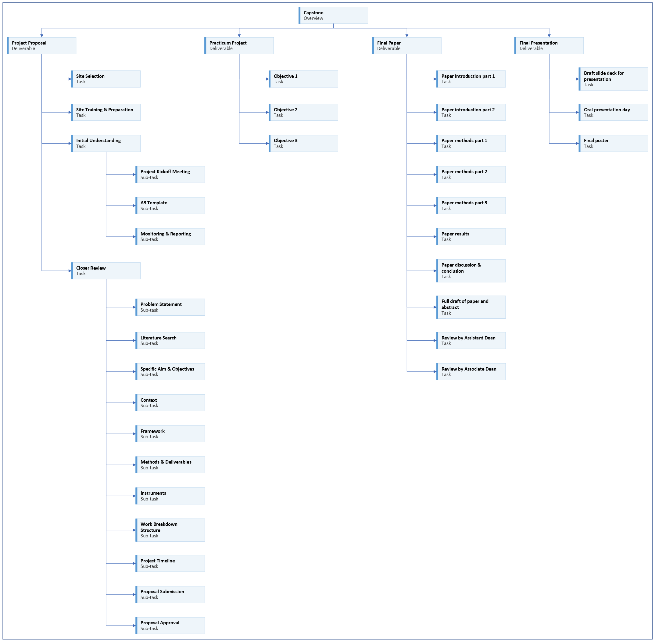
Notes:
We are working on the project proposal portion of your capstone.
[Next slide]

Slide 3
Notes:
Last time we talked about the instruments you may use or create for your project.
[Next slide]

Slide 4
Notes:
Today we will talk about how to create a work breakdown structure list and diagram for your project.
[Next slide]

Slide 5

Address feedback
Notes:
You should be addressing any feedback on your assignments and pasting updated content in the appropriate sections.
[next slide]

Slide 6
Work breakdown structure purpose
(Schwalbe, 2021)
Notes:
A work breakdown structure (WBS) is a deliverable-oriented grouping of the work involved in a project that defines the total scope of the project.
The WBS is a document that breaks all the work required for the project into discrete deliverables and groups them into a logical hierarchy.
The WBS helps put the project team on the same page.
If something is missing, it should be added to the WBS.
If something additional is added to the WBS which is not intended to be completed as part of this project, it should be removed.
A WBS is often depicted in a graphical format, similar to an organizational chart.
The name of the entire project is in the top box, called Level 1, and the main groupings for the work are listed in the second tier of boxes called level 2.
Additional breakdown can be done with additional levels.
One of the main purposes of a WBS is to help breakdown major project deliverables into smaller ones.
This is a WBS diagram I created that lists the main deliverables for Capstone. (Your project proposal, practicum project, final paper, and presentation)
[Next slide]

Slide 7
Work breakdown structure design
(Schwalbe, 2021)
Notes:
The WBS should include only the project deliverables and not the tools, techniques, or actions to create those deliverables.
The WBS helps you define the deliverables your project should deliver to be successful.
One basic method to verify that your WBS is complete is to look at the lowest level of your deliverables and assess if they in combination will give you everything you need to create the higher-level deliverables.
Notice that nouns are used to describe the deliverables and not verbs.
The main thing to understand is that you’re organizing the main deliverables based on the work that needs to be done and not how the work will be done.
The depth at which you decompose a deliverable depends on the complexity of the work, the uniqueness of the work, and the experience of the team.
It is good to note the WBS includes the deliverables, but not the detailed characteristics of the deliverables.
Specific details of deliverables should be outlined elsewhere.
[Next slide]

Slide 8

Wbs list
Project Name
Objective 1 | Objective 2 | Objective 3 | Objective 4
Deliverable 1 | Deliverable 4 | Deliverable 7 | Deliverable 8
Deliverable 2 | Task 4 |  | Deliverable 9
Task 1 | Task 5
Task 2 | Task 6
Task 3 | Deliverable 5
Deliverable 3 | Deliverable 6
Notes:
We’re going to create a WBS list in Microsoft Excel.
[click]
I have included a sheet called WBS-List in your Capstone Toolkit
[next slide]

Slide 9
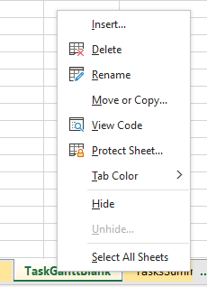
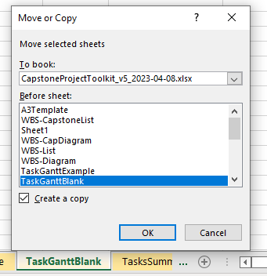
Copy sheet
Notes:
If you want to work directly in the sample table in Excel, create a copy of the sheet and work in the copy.
You can delete the copy if you want to start over.
[click]
To copy a sheet in Excel, right-click on the tab for the sheet.
You will see a pop-up menu.
Select Move or Copy…
[click]
Check the box for Create a copy.
And select the sheet you want the copy to be next to.
Click OK
[next slide]

Slide 10
Wbs list
Project Name
Objective 1 | Objective 2 | Objective 3 | Objective 4
Deliverable 1 | Deliverable 4 | Deliverable 7 | Deliverable 8
Deliverable 2 | Task 4 |  | Deliverable 9
Task 1 | Task 5
Task 2 | Task 6
Task 3 | Deliverable 5
Deliverable 3 | Deliverable 6
Notes:
[click]
This table is in the WBS-List sheet in your Capstone Toolkit.
[click]
List a short name for your project in the top row.
[click]
List your objectives in separate columns in the row below the project name.
I like to merge and center the cells for the project name above the objective cells.
[click]
Go through each of your objectives and list the deliverables for that objective in separate rows below the objective.
Increase the indent for the rows that have the deliverables.
This makes it easier to see the hierarchy of the objectives and the deliverables.
[click]
If any of your deliverables can be broken down further to sub-deliverables or major tasks that need to be completed for that deliverable, list them under their deliverable.
Increase the indent for the sub-deliverables under their respective deliverable.
This makes it easier to see which sub-deliverables belong to which deliverable.
[click]
You can select the entire table and copy and paste it into your project proposal in the WBS diagram section.
I like to add borders in Excel before I copy and paste. Add borders around the outside of the table and between all of the cells.
If you want to make a WBS diagram for your project like I’ve been using in these presentations, I’ll make a separate video with instructions and a demonstration of how to do that.
It’s a little bit more complicated, so we don’t need to go into it here.
This list version of the work breakdown structure is sufficient for your project proposal.
In fact, this may be a good point to stop for a while.
If things change, it’s simple to update this list.
It’s a bit more work to redo the diagram.
(I made a couple of different versions of my diagram while I was working on these presentations.)
A more finished diagram might make a nice addition to your final paper.
Mentioning that you took the time to create a work breakdown structure for your project will make a nice addition to your methods.
[next slide]

Slide 11

assignment
Project Name
Objective 1 | Objective 2 | Objective 3 | Objective 4
Deliverable 1 | Deliverable 4 | Deliverable 7 | Deliverable 8
Deliverable 2 | Task 4 |  | Deliverable 9
Task 1 | Task 5
Task 2 | Task 6
Task 3 | Deliverable 5
Deliverable 3 | Deliverable 6
Notes:
[click]
Your assignment is to create a work breakdown structure list for your project proposal.
[next slide]

Slide 12

More to come . . .
Notes:
That’s all we’ll do in this video.
There is more to come.
[next slide]

Slide 13
References
Schwalbe, K. (2021). Healthcare project management, third edition: Predictive, agile, and hybrid approaches. Schwalbe Publishing.

